Slide 1
Mitigating GPU Core Partitioning Performance Effects
Aaron Barnes, Fangjia Shen, Timothy G. Rogers
Purdue University
HPCA 2023
2/27/2023

Slide 2
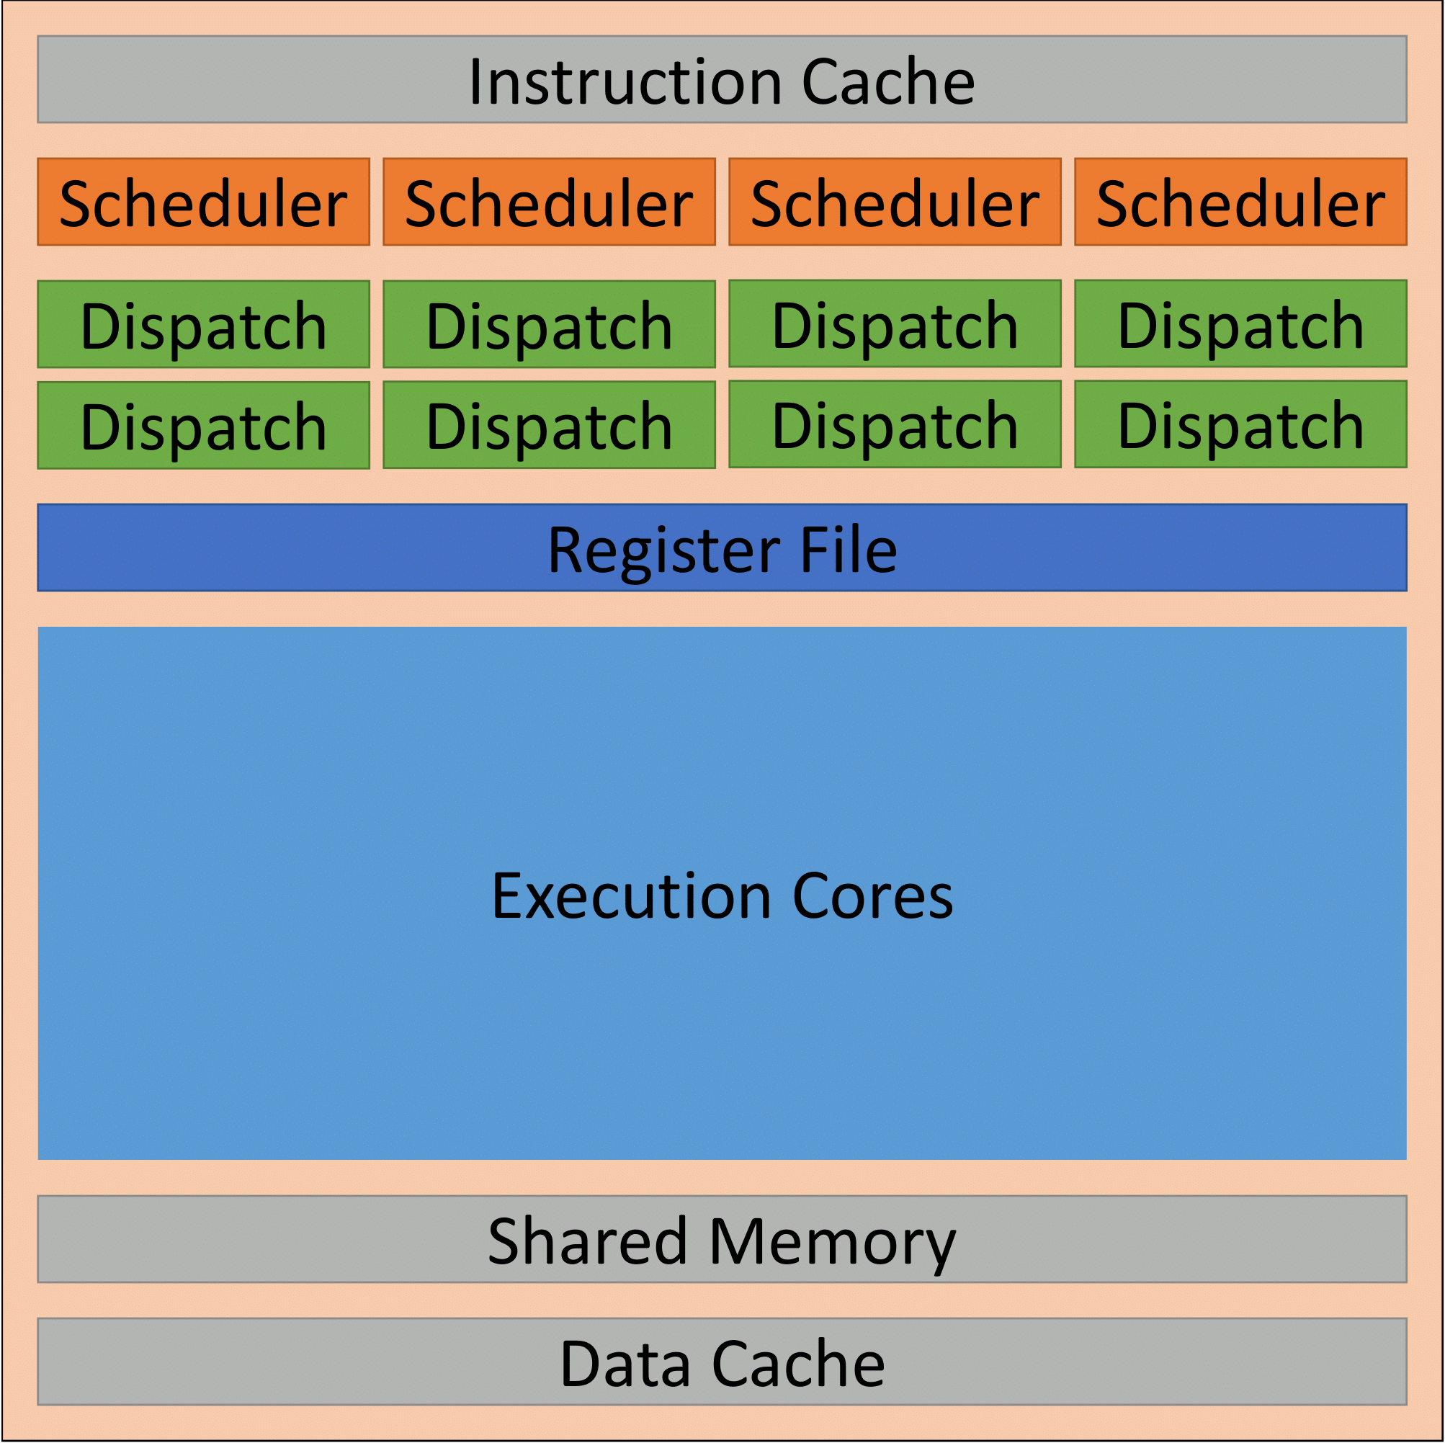
Two Generations of SM Architectures
Kepler (2012)
Notes:
Block diagram of Nvidia SM from over a decade ago
4 schedulers share reg file
Full crossbar connectivity – any scheduler assign work to any exec unit

Slide 3
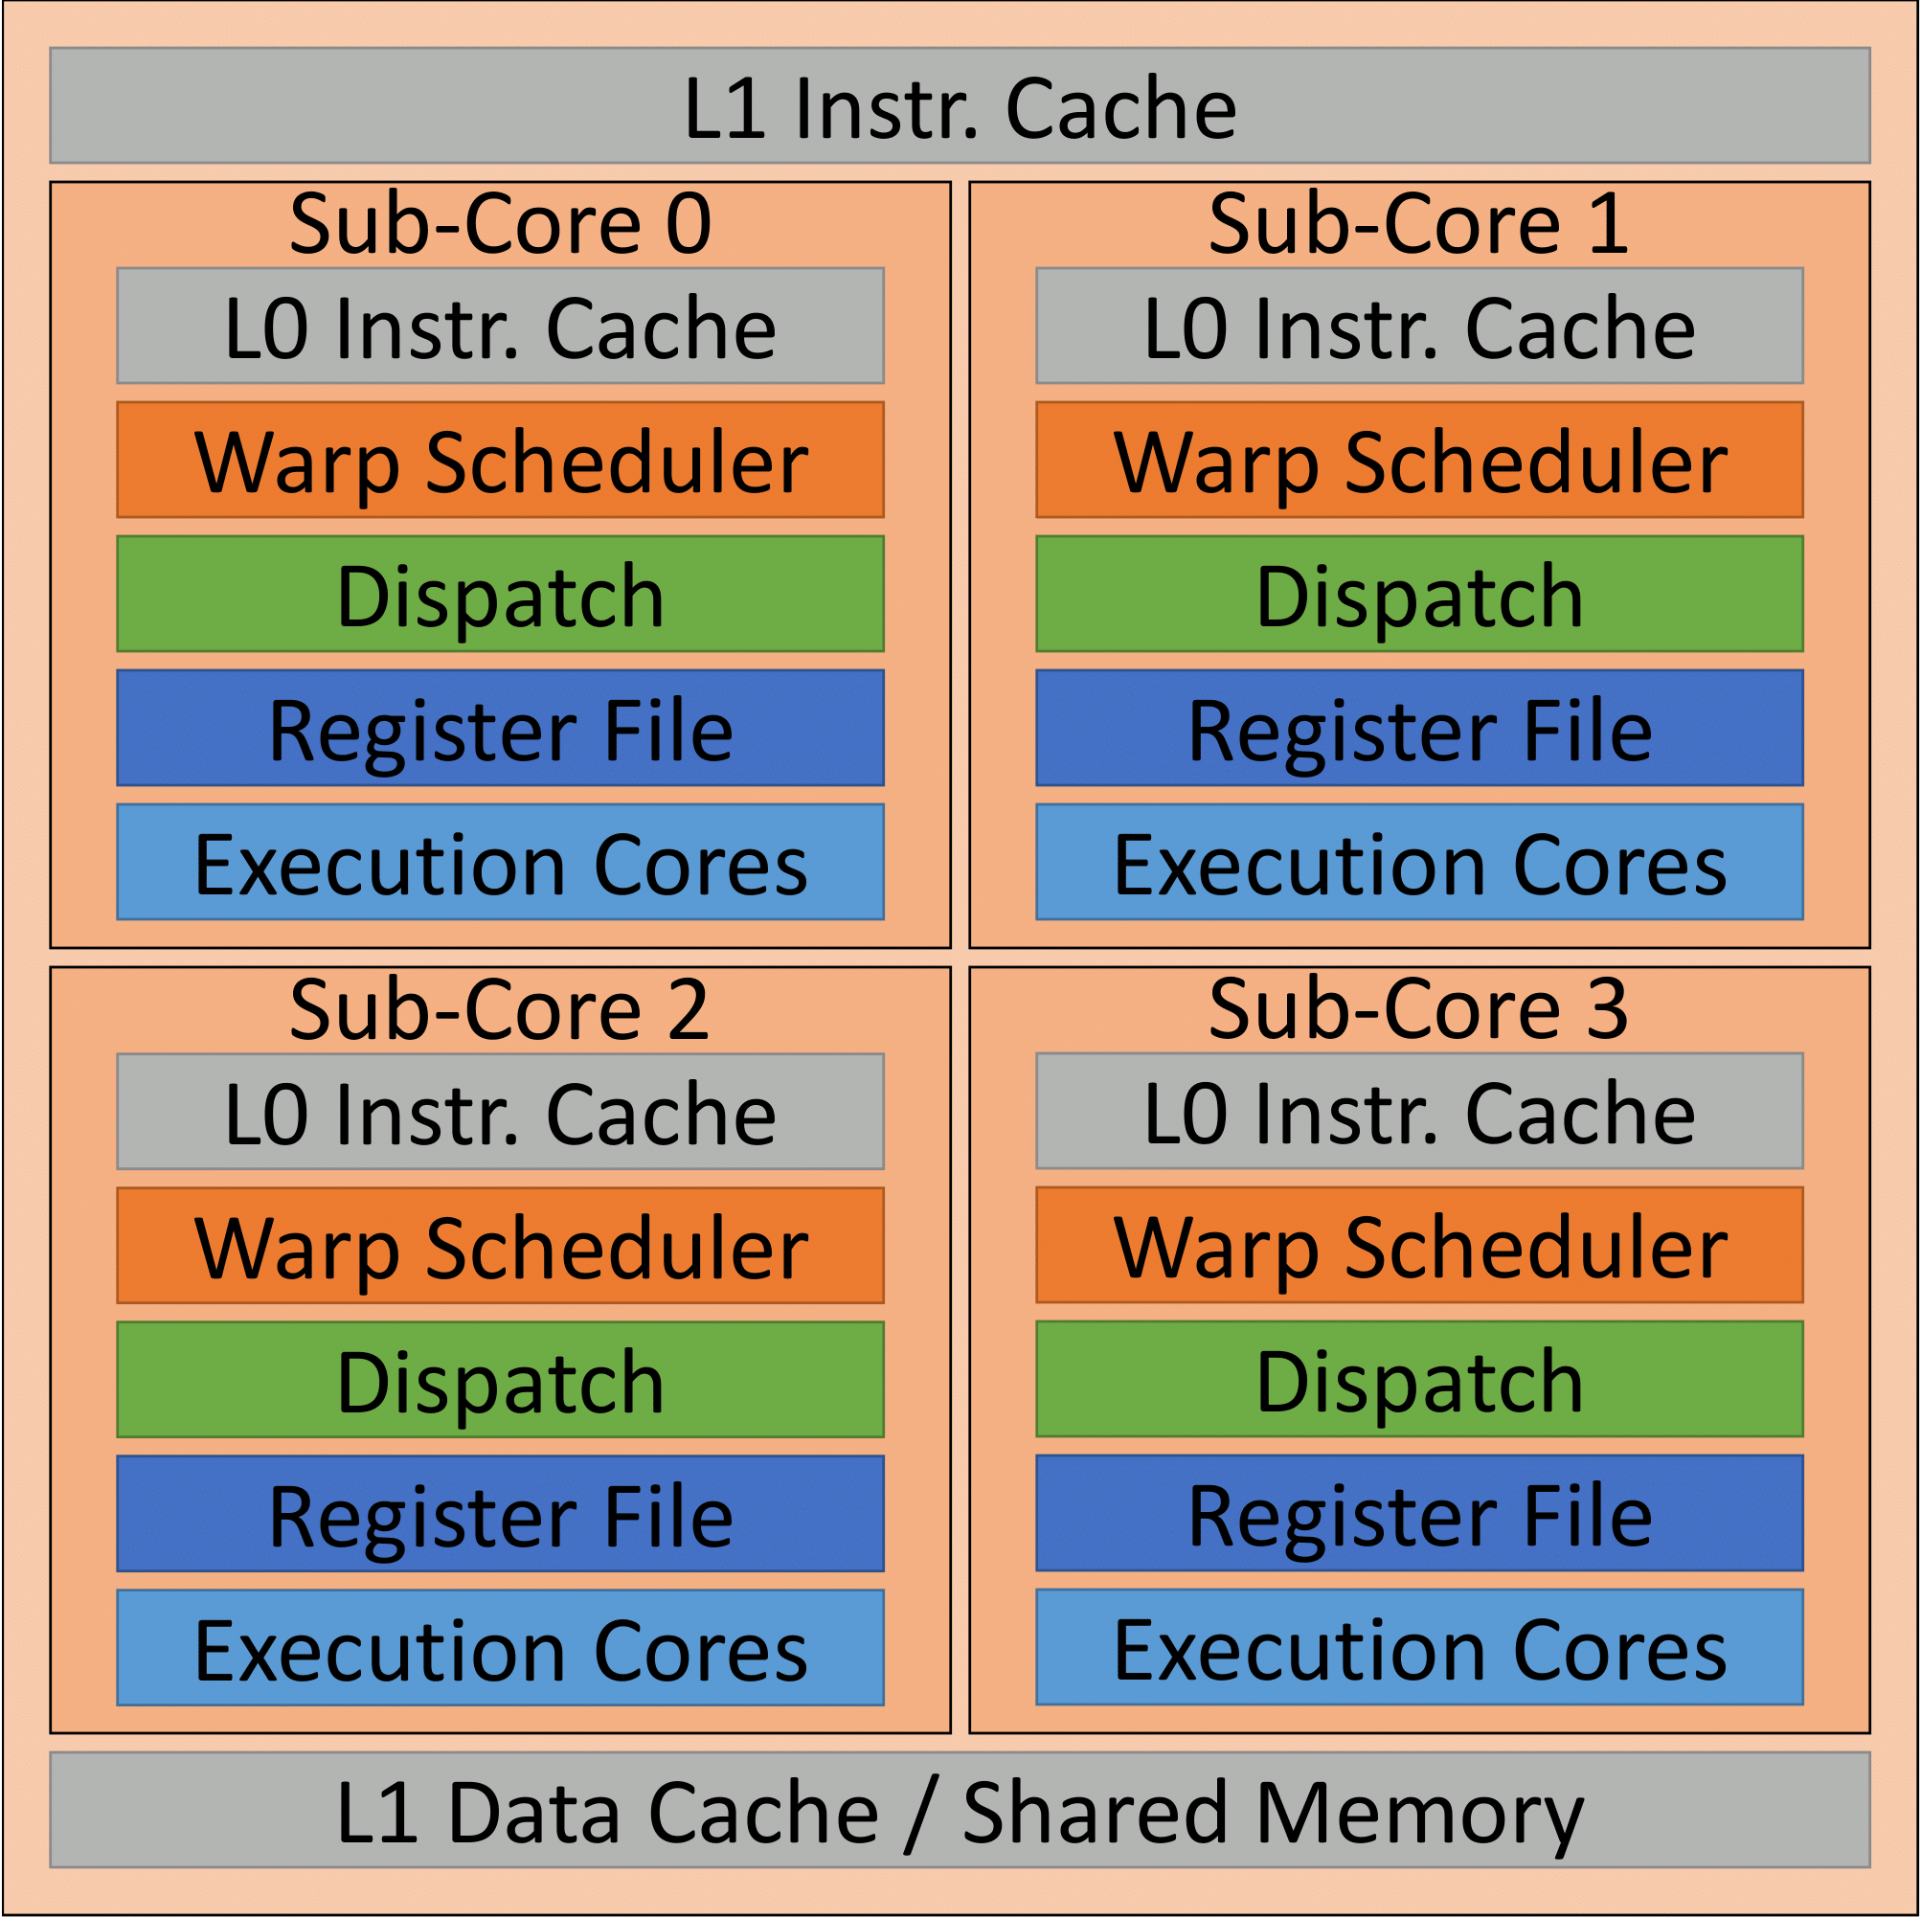
Two Generations of SM Architectures
Kepler (2012)
Hopper
(2022)
Notes:
Volta, Ampere, and Hopper, partition their resources into four distinct units called sub-cores to reduce area and energy connectivity costs.
In this work I address two partitioning effects that have a significant effect on performance.
Also Identify 2 more that we can discuss at the end if there is time (multi-kernel)

Slide 4
Two Generations of SM Architectures
1. Partitioned Register files have fewer banks and Collector Units (CUs) per thread
Kepler (2012)
Hopper
(2022)
Notes:
1st partitioned register files have fewer banks and Cus available to each thread

Slide 5
Two Generations of SM Architectures
2. Warp Scheduler can only issue instructions to Execution Units in the same sub-core, imbalances cause under-utilization
Kepler (2012)
Hopper
(2022)
Notes:
2nd warp scheduler can only issue from ¼ of the pool of warps in the threadblock and can issue to ¼ of the available EUs

Slide 6
SM Register File Banks
Warp Scheduler
Warp Scheduler
Warp Scheduler
Warp Scheduler
Bank 0
Bank 1
Bank 2
Bank 3
Bank 4
Bank 5
Bank 6
Bank 7
Notes:
More detail of partitioned register file banking
Each sched has 2 RF banks
Want to model a hypothetical fully-connected core with modern amount of compute resources

Slide 7
SM Register File Banks
Warp Scheduler
Warp Scheduler
Warp Scheduler
Warp Scheduler
Bank 0
Bank 1
Bank 2
Bank 3
Bank 4
Bank 5
Bank 6
Bank 7
Notes:
Hypothetical fully connected core looks like this
Threads can distribute operands across more banks
BUT more schedulers competing for access at once

Slide 8
SM Register File Banks
Warp Scheduler
Warp Scheduler
Warp Scheduler
Warp Scheduler
Bank 0
Bank 1
Bank 2
Bank 3
Bank 4
Bank 5
Bank 6
Bank 7
# of Register Banks and Execution Units Stays the Same!
Notes:
Total resources stays the same
Not shown: full connectivity for execution units too, can issue to any EU on the SM

Slide 9
Hypothetical Fully-Connected SM
Notes:
112 applications studied.
categorize the applications that benefit from the fully-connected SM into three groups:
1st apps that aren’t affected by reduced connectivity of sub cores
Apps shown here:
Not reg file intensive
Balanced warps complete at around the same rate

Slide 10
Hypothetical Fully-Connected SM
Notes:
2nd: Apps that have regions where they are bottlenecked by the read operand stage
High sustained or bursty register file accesses
Large # bank conflicts

Slide 11
Hypothetical Fully-Connected SM
Notes:
3rd: apps with inter-warp imbalances.
Primarily seen in TPCH benchmarks,
individual warps within a threadblock have different amounts of work to accomplish causing imbalance.

Slide 12
Outline
Background and Motivation
Register Bank Aware (RBA) Warp Scheduling
Hashed Sub-core Warp Assignment
Evaluation and Conclusion
Notes:
2 independent techniques

Slide 13
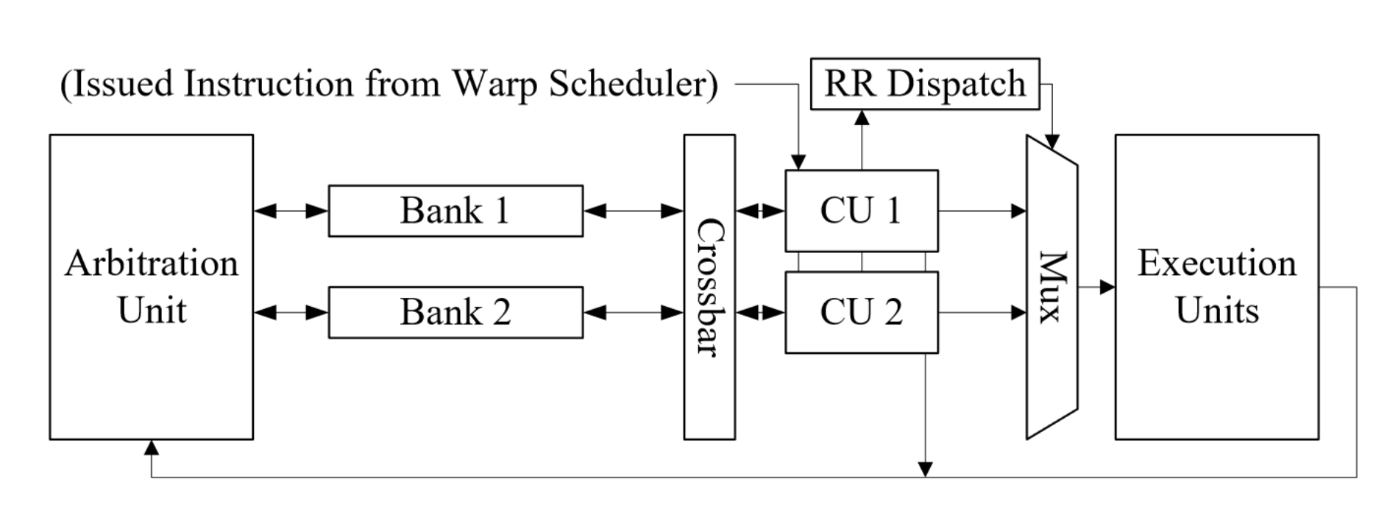
The Operand Collector
Each Collector Unit (CU) buffers one warp instruction
Instructions from other warps used to hide bank conflicts
Notes:
To understand RBA must first have understanding of operand collection stage in GPUs

Slide 14
Simple Operand Collector Example
// Thread block Code
i0: add r0 r2 r4
i1: fma r1 r3 r4 r5
Notes:
Run through quick example of OCU
Start with TB code
2 instructions:
r0 = r2 + r4
R1 = r3*r4 + r5

Slide 15
Simple Operand Collector Example
// Thread block Code
i0: add r0 r2 r4
i1: fma r1 r3 r4 r5
W0:i0: add r0 r2 r4
W0:i1: fma r1 r3 r4 r5
W1:i0: add r0 r2 r4
W1:i1: fma r1 r3 r4 r5
W2:i0: add r0 r2 r4
W2:i1: fma r1 r3 r4 r5
Notes:
TB consists of more than one thread, in this example we have 3 warps
No divergence among threads

Slide 16
Simple Operand Collector Example
// Thread block Code
i0: add r0 r2 r4
i1: fma r1 r3 r4 r5
W0:i0: add r0₀ r2₀ r4₀
W0:i1: fma r1₁ r4₀ r5₁ r1₁
W1:i0: add r0₁ r2₁ r4₁
W1:i1: fma r1₀ r4₁ r5₀ r1₀
W2:i0: add r0₀ r2₀ r4₀
W2:i1: fma r1₁ r4₀ r5₁ r1₁
Simple Register Swizzling:
bankID = (regID + WarpID) % 2
Notes:
Registers for each warp stored in RF banks
Perform swizzling to reduce bank conflicts between warps

Slide 17
Simple Operand Collector Example
// Thread block Code
i0: add r0 r2 r4
i1: fma r1 r3 r4 r5
Collector Unit 0 (CU0)
Collector Unit 1 (CU1)
W0:i0: add r0₀ r2₀ r4₀
W0:i1: fma r1₁ r4₀ r5₁ r1₁
W1:i0: add r0₁ r2₁ r4₁
W1:i1: fma r1₀ r4₁ r5₀ r1₀
W2:i0: add r0₀ r2₀ r4₀
W2:i1: fma r1₁ r4₀ r5₁ r1₁
Simple Register Swizzling:
bankID = (regID + WarpID) % 2
Notes:
2 CU baseline

Slide 18
Simple Operand Collector Example
// Thread block Code
i0: add r0 r2 r4
i1: fma r1 r3 r4 r5
CYCLE 0
Collector Unit 0 (CU0)
Collector Unit 1 (CU1)
W0:i0: add r0₀ r2₀ r4₀
W0:i1: fma r1₁ r4₀ r5₁ r1₁
W1:i0: add
r0₁ r2₁ r4₁
Warp Scheduler ISSUES
W1:i1: fma r1₀ r4₁ r5₀ r1₀
W2:i0: add r0₀ r2₀ r4₀
W2:i1: fma r1₁ r4₀ r5₁ r1₁
Simple Register Swizzling:
bankID = (regID + WarpID) % 2
Notes:
Cycle 0
Issue w1 i1 into free collector unit
Many different Warp scheduling policies, common include RR and GTO
Programmer doesn’t know which warps are issued each cycle

Slide 19
Simple Operand Collector Example
// Thread block Code
i0: add r0 r2 r4
i1: fma r1 r3 r4 r5
CYCLE 1
Collector Unit 0 (CU0)
Collector Unit 1 (CU1)
W0:i0: add r0₀ r2₀ r4₀
W0:i1: fma r1₁ r4₀ r5₁ r1₁
W1:i0: add
r0₁ r2₁ r4₁
W2:i0: add
r0₀ r2₀ r4₀
W1:i1: fma r1₀ r4₁ r5₀ r1₀
Warp Scheduler ISSUES
W2:i1: fma r1₁ r4₀ r5₁ r1₁
Simple Register Swizzling:
bankID = (regID + WarpID) % 2
Notes:
Cycle 1
CU 0 accesses bank 1
WS issues W2 i1 to CU 1

Slide 20
Simple Operand Collector Example
// Thread block Code
i0: add r0 r2 r4
i1: fma r1 r3 r4 r5
CYCLE 2
Warp Scheduler ISSUES
Collector Unit 0 (CU0)
Collector Unit 1 (CU1)
W0:i1: fma r1₁ r4₀ r5₁ r1₁
W0:i0: add
r0₀ r2₀ r4₀
W2:i0: add
r0₀ r2₀ r4₀
W1:i1: fma r1₀ r4₁ r5₀ r1₀
CU DISPATCH
W2:i1: fma r1₁ r4₀ r5₁ r1₁
To SIMD Execution Units:
W1:i0 add r0₁ r2₁ r4₁
Simple Register Swizzling:
bankID = (regID + WarpID) % 2
Notes:
Cycle 2
CU 0 access bank1 and dispatches W1 i1 since all operands gathered
WS issues W0 i1 to CU 0
CU 1 access bank 0
Note both Cus are now going to be attempting to access bank 0

Slide 21
Simple Operand Collector Example
// Thread block Code
i0: add r0 r2 r4
i1: fma r1 r3 r4 r5
No free CU -> Warp Scheduler Stalls this cycle
CYCLE 3
Collector Unit 0 (CU0)
Collector Unit 1 (CU1)
W0:i1: fma r1₁ r4₀ r5₁ r1₁
W0:i0: add
r0₀ r2₀ r4₀
W2:i0: add
r0₀ r2₀ r4₀
Bank Conflict!
W1:i1: fma r1₀ r4₁ r5₀ r1₀
W2:i1: fma r1₁ r4₀ r5₁ r1₁
Simple Register Swizzling:
bankID = (regID + WarpID) % 2
Notes:
Bank conflict!
Arbiter had to choose, and it chose CU 0
WS had to stall

Slide 22
Register Bank Aware Warp Scheduling
16 Entry
Warp PC Table
Warp Selection Logic
Issued Warp
Collector Units
(CUs)
Notes:
Real HW can schedule more than 3 Warps
WS logic simple comparator tree based on warp age for GTO
Issue to Cus as previously shown

Slide 23
Register Bank Aware Warp Scheduling
16 Entry
Warp PC Table
Warp Selection Logic
Issued Warp
Arbitration Unit
Collector Units
(CUs)
Register File Bank 0
Register File Bank 1
X-bar
Bank Read Requests
Notes:
Previously mentioned: arbitration unit logic determines which Cus get to access which bank
Cus signal Arbiter with bank read requests

Slide 24
Register Bank Aware Warp Scheduling
16 Entry
Warp PC Table
Warp Selection Logic
Issued Warp
Arbitration Unit
Collector Units
(CUs)
Register File Bank 0
Register File Bank 1
X-bar
Bank Read Requests
Notes:
RBA tries to avoid bank conflicts upstream by modifying the warp selection logic
Prioritize warp instructions that will access banks with fewer pending requests

Slide 25
Register Bank Aware Warp Scheduling
RBA Scoring
Logic
16 Entry
Warp PC Table
Warp Selection Logic
Issued Warp
Request Queue Lengths
Arbitration Unit
Collector Units
(CUs)
Register File Bank 0
Register File Bank 1
X-bar
Bank Read Requests
Notes:
Generate scores using feedback from the arbitration unit
Score = num_ops0 * length (q0) + num_ops1 * length (q1)

Slide 26
Register Bank Aware Warp Scheduling
RBA Scoring
Logic
16 Entry
Warp PC Table
Warp Selection Logic
Issued Warp
Request Queue Lengths
Arbitration Unit
Collector Units
(CUs)
Register File Bank 0
Register File Bank 1
X-bar
Bank Read Requests
Main Idea: Use feedback from the Collector Unit to improve Warp Scheduling

Slide 27
Outline
Background and Motivation
Register Bank Aware (RBA) Warp Scheduling
Hashed Sub-core Warp Assignment
Evaluation and Conclusion
Notes:
Now I will further describe the sub-core issue imbalance problem, and how we can use hashed warp assignment to minimize its impact.

Slide 28

How are warps assigned to sub-cores in HW?
PCIe Interface
Thread Block Scheduler
SM
SM
SM
SM
SM
SM
SM
SM
Kernel Launch
SM
SM
SM
SM
L2 Cache
SM
SM
SM
SM
HOST
SM
SM
SM
SM
SM
SM
SM
SM
GPU
Notes:
GPUs have many levels of scheduling
Host launches kernels
Kernels made up of many TBs
TB scheduler assigns TBs to SMs

Slide 29
How are warps assigned to sub-cores in HW?
PCIe Interface
Interconnect Arbiter
Thread Block Scheduler
Sub Core Scheduler
SM
SM
SM
SM
Sub-core 0
Sub-core 1
SM
SM
SM
SM
Kernel Launch
SM
SM
SM
SM
Sub-core 2
Sub-core 3
L2 Cache
SM
SM
SM
SM
HOST
SM
SM
SM
SM
Streaming Multiprocessor
SM
SM
SM
SM
GPU
Notes:
Interconnect arbiter receives new TB
Unknown scheduling must assign warps to individual sub-cores
Sub-core allocated warp granularity
Fully released at TB granularity (PC table / shared mem)
Hypothesis: Sub-cores use RR scheduling

Slide 30
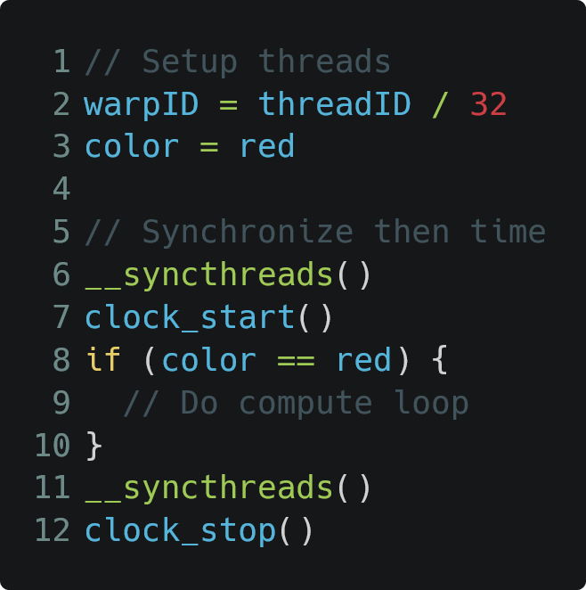
Sub-Core Assignment Microbenchmark
Thread Block (Baseline)
0
1
2
3
4
5
6
7
Sub-Cores
Notes:
Hypothesis is RR
Want to design a microbench to determine if true
If hypothesis is true each column of threadblock in fig is to a different sub-core
Benchmark code shown
Tested on multiple GPUs from Nvidia and AMD
Kepler has no sub-cores

Slide 31
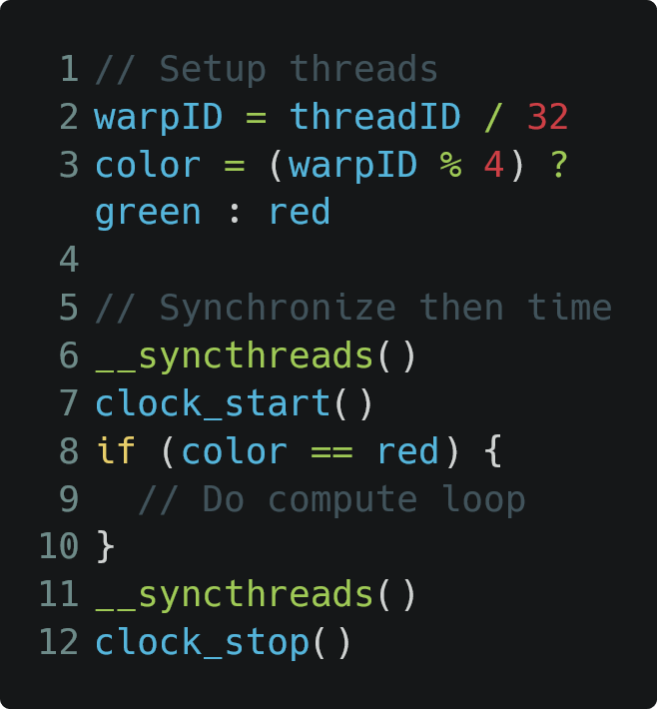
Sub-Core Assignment Microbenchmark
Thread Block (Unbalanced)
0
1
2
3
4
5
6
7
Thread Block (Baseline)
8
9
10
11
0
1
2
3
12
13
14
15
16
17
18
19
20
21
22
23
4
5
6
7
24
25
26
27
28
29
30
31
Sub-Cores
Sub-Cores
Notes:
Add Green warps
RR scheduling causes all red warps to be assigned to the same sub-core
Increases execution time 3-3.9X on modern GPUs
Fully connected Kepler GPU unaffected

Slide 32
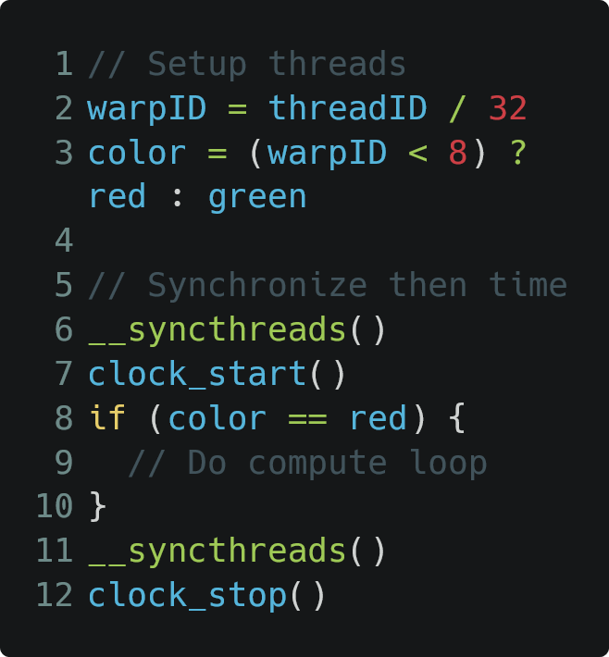
Sub-Core Assignment Microbenchmark
Thread Block (Unbalanced)
Thread Block (Balanced)
0
1
2
3
0
1
2
3
4
5
6
7
4
5
6
7
Thread Block (Baseline)
8
9
10
11
8
9
10
11
0
1
2
3
12
13
14
15
12
13
14
15
16
17
18
19
16
17
18
19
20
21
22
23
20
21
22
23
4
5
6
7
24
25
26
27
24
25
26
27
28
29
30
31
28
29
30
31
Sub-Cores
Sub-Cores
Sub-Cores
Notes:
We can balance the empty threads by restructuring their thread id
Runtime returns to baseline
Questions?

Slide 33
Warp Imbalance in Real Applications
A
B
C
D
Time
INTRA-warp divergence
Notes:
Real applications can also suffer from warp imbalance
Intra-warp divergence – threads on different control flow paths – causes SIMD masking / serialization of each branch
4-SIMD unit example
Branching code takes basic block paths B and C
Reconverges at D

Slide 34
Warp Imbalance in Real Applications
A
B
C
D
TB
TB
TB
W0
W0
W0
W1
W2
W2
W3
Time
Time
INTRA-warp divergence
INTER-warp divergence
Notes:
Inter-Warp divergence – warps reaching a barrier or completing at different times – can lead to sub-core imbalance
This can cause imbalance across the subcores like the ones seen in the microbench

Slide 35
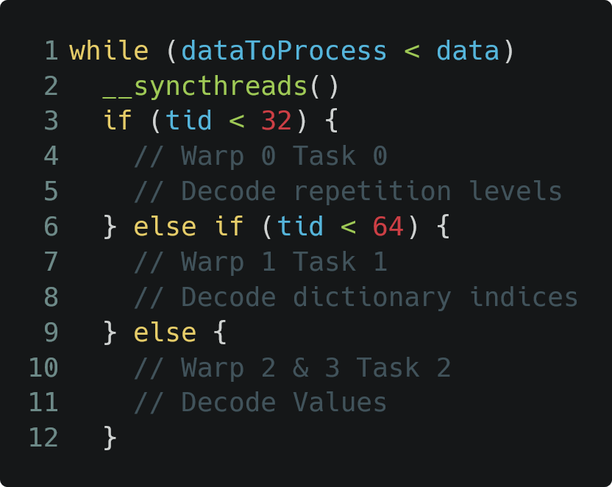
Warp Imbalance in Real Applications
A
B
C
D
TB
TB
TB
W0
W0
W0
W1
W2
W2
W3
Time
Time
INTRA-warp divergence
INTER-warp divergence
Warp Specialized Programming
Notes:
Real apps don’t have “empty threads” but can suffer from inter-warp div
Warp specialized programming – avoids intra-warp divergence by giving each group of 32 threads a unique task, making them highly efficient
prone to inter-warp divergence
Example code follows similar structure to the longest running kernel from the cuDF library used to execute TPCH SQL queries
Through profiling we found Task 0 is significantly more compute intensive

Slide 36
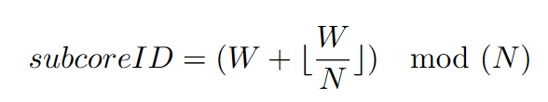
Static Skewed Round Robin (SRR)
Replace the Round Warp PC multiplexer with a different static hashing function to avoid pathological imbalances
Sub-Core 0
Sub-Core 1
Thread Block
0
Sub-Core 2
Sub-Core 3
1
2
3
4
5
6
7
8
9
10
11
12
13
14
15
16
17
18
19
20
21
22
23
24
25
26
27
28
29
30
31
Notes:
Idea: replace RR scheduling with something that matches the imbalance seen in TPC-H
TB shown roughly matches TPC-H imbalance profile
SRR -> shifts the starting sub-core by 1 every 4 assignments

Slide 37
Static Skewed Round Robin (SRR)
Replace the Round Warp PC multiplexer with a different static hashing function to avoid pathological imbalances
Sub-Core 0
Sub-Core 1
0
1
Thread Block
0
Sub-Core 2
Sub-Core 3
1
2
3
4
5
6
7
2
3
8
9
10
11
12
13
14
15
16
17
18
19
20
21
22
23
24
25
26
27
28
29
30
31
Notes:
For example, after the first round of scheduling, the first four warps would be assigned like this.

Slide 38
Static Skewed Round Robin (SRR)
Replace the Round Warp PC multiplexer with a different static hashing function to avoid pathological imbalances
Sub-Core 0
Sub-Core 1
0
7
1
4
Thread Block
0
Sub-Core 2
Sub-Core 3
1
2
3
4
5
6
7
2
5
3
6
8
9
10
11
12
13
14
15
16
17
18
19
20
21
22
23
24
25
26
27
28
29
30
31
Notes:
The next four warps are shifted by one, such that the long running warp will be distributed to a different sub-core. The pattern continues for the remaining warps in the threadblock.

Slide 39
Random Shuffle
Random permutation selected to order warps assigned four each time
Sub-Core 0
Sub-Core 1
Thread Block
0
Sub-Core 2
Sub-Core 3
1
2
3
4
5
6
7
8
9
10
11
12
13
14
15
16
17
18
19
20
21
22
23
24
25
26
27
28
29
30
31
Notes:
Alternatively, we can use a random permutation to select the sub-core assignment of warps each cycle of warps.
Not specific to TPC-H benchmark, avoids pathological imbalances

Slide 40
Random Shuffle
Random permutation selected to order warps assigned four each time
Round 1: 2,0,1,3
Sub-Core 0
Sub-Core 1
1
3
Thread Block
0
Sub-Core 2
Sub-Core 3
1
2
3
4
5
6
7
0
2
8
9
10
11
12
13
14
15
16
17
18
19
20
21
22
23
24
25
26
27
28
29
30
31
Notes:
Random shuffling could assign the first round like this

Slide 41
Random Shuffle
Random permutation selected to order warps assigned four each time
Round 1: 2,0,1,3
Round 2: 0,3,1,2
Sub-Core 0
Sub-Core 1
1
4
3
6
Thread Block
0
Sub-Core 2
Sub-Core 3
1
2
3
4
5
6
7
0
7
2
5
8
9
10
11
12
13
14
15
16
17
18
19
20
21
22
23
24
25
26
27
28
29
30
31
Notes:
By selecting a new random permutation, the sub-core ID is abstracted from the thread id which reduces the likelihood of all long-running warps ending on the same sub-core.

Slide 42
Random Shuffle
Random permutation selected to order warps assigned four each time
Round 1: 2,0,1,3
Round 2: 0,3,1,2
Round 3: 2,1,0,3
Sub-Core 0
Sub-Core 1
1
4
10
3
6
9
Thread Block
0
Sub-Core 2
Sub-Core 3
1
2
3
4
5
6
7
0
7
8
2
5
11
8
9
10
11
12
13
14
15
16
17
18
19
20
21
22
23
24
25
26
27
28
29
30
31
Notes:
However, random shuffle hashing can still result in sub-optimal assignment.

Slide 43
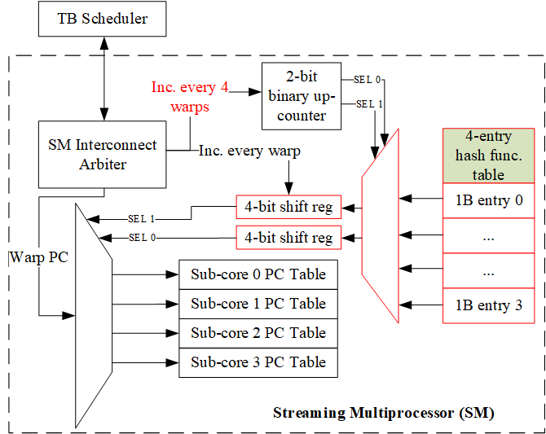
Small Hash table for Sub-Core Warp Assignment
Hardware to modify RR multiplexer for Sub-Core Assignment
We add 4-entry 1 byte-per-entry hash table
Support different programmable hashing functions
Sensitivity Study details in Paper
Notes:
Hashed sub-core assignment can be supported with minimal modifications to the baseline round robin multiplexer. We add a 4-entry hash table to store the hash function for each round of scheduling. Each entry specifies the assignment of four consecutive warp assignments. These entries are shifted into 4-bit shift registers that drive the select lines of the 4:1 sub-core multiplexer.

Slide 44
Outline
Background and Motivation
Register Bank Aware (RBA) Warp Scheduling
Hashed Sub-core Warp Assignment
Evaluation and Conclusion
Notes:
I will now discuss our methodology, key results, and conclusion.

Slide 45
Methodology
Simulation Methodology
Accel-Sim with GPGPU-Sim 4.0 and Volta V100 Model
112 Applications from 8 diverse benchmark suites
2 register file banks per sub-core, 8 per SM
2 CUs per sub-core, 8 per SM
RTL Power / Area Analysis of RBA vs CU scaling
Cadence Genus
Synthesized RBA and Operand Collector with 45nm PDK
SRAM modules using OpenRAM
Notes:
Two CUs per sub-core were used in our baseline design after performing a sweep in accelsim from 1 to 4 sub-cores and correlating it with in-silicon results.
Since scaling CUs is also a valid method for reducing the impact of bank conflicts, we implemented the operand collector and RBA scheduler in RTL to provide a detailed power and area comparison.

Slide 46
Summary Design Performance
Notes:
Evaluate related work on Volta configuration with only 2 banks / Cus
Steals a free bank at the current cycle for an operand that is supposed to be fetched in the next cycle
Beneficial for unterutilized RF with large number of banks
2 Requirements for Bank stealing to occur:
1. Free CU
2. Stealing should resolve a conflict and not cause a conflict in current cycle

Slide 47
Summary Design Performance
Notes:
Combined perf of our techniques
11.2% Avg speedup across all 112 Apps
Some apps more sensitive than others

Slide 48
Summary Design Performance
Notes:
only 2% less than the 13.2% average speedup of the fully connected SM.

Slide 49
Summary Design Performance
TPC-H benchmarks benefit the most from SRR and hashed warp assignment

Slide 50
Summary Design Performance
Other applications benefit most from RBA
Notes:
Other applications bottlenecked in the read operand stage, with minimal sub-core imbalance.
Some cases RBA outperforms Fully Connected

Slide 51
RBA improves Fully-Connected too!
Notes:
A fully connected SM allows each thread to distribute its operands across 8 banks instead of two, but unlike the partitioned SM, it must share bank requests from warps issued from all four schedulers.
Further, although RBA is beneficial to sub-core divided SMs with a small number of register file banks, it can also provide benefit to highly contended register files with more banks, as shown in this figure.

Slide 52
Alternative Design Approach: Increasing # Collector Units / Sub-Core
Prevents Scheduler Issue stalls due to occupied CUs
Increases the ability to hide bank conflicts with other instructions
Collector Unit 0 (CU0)
Collector Unit 1 (CU1)
Scaling
Collector Unit 0 (CU0)
Collector Unit 1 (CU1)
Collector Unit 2 (CU1)
Collector Unit 3 (CU1)
Notes:
Alternative to RBA add more Cus per sub-core
We evaluated the performance, and area / power implications of such a strategy

Slide 53
Collector Unit (CU) Scaling Performance
Notes:
CU scaling improved average performance by 4.1, 7.1, and 9.6 % for 4,8, and 16 Cus per sub-core respectively.
TPCH isn’t RF bank conflict sensitive
Some apps like mriq highly sensitive

Slide 54
Power and Area analysis of CU Scaling vs RBA
Notes:
Scaling the number of Cus is extremely expensive due to the large operand data fields for each CU, and full crossbar bank-CU connectivity. Alternatively, adding RBA scheduling to a 2 CU design only increases normalized area and power costs by 1%.

Slide 55
Conclusion
Goals
Reduce bank conflicts in partitioned SMs without costly CU scaling
Eliminate pathological sub-core issue imbalances
Design
RBA uses feedback from the operand collector stage to relieve bank conflict pressure in highly contended register file sensitive apps
Hashed sub-core assignment reduces the likelihood of sub-core issue imbalances
Key Results
Average of 11.2% speedup capturing 81% of performance lost due to SM sub-division
RBA provides equivalent performance of between 4 and 8 CUs per sub-core with only a 1% increase in normalized area and power
Notes:
Leave slide up for Questions

Slide 56
Conclusion
Goals
Reduce bank conflicts in partitioned SMs without costly CU scaling
Eliminate pathological sub-core issue imbalances
Design
RBA uses feedback from the operand collector stage to relieve bank conflict pressure in highly contended register file sensitive apps
Hashed sub-core assignment reduces the likelihood of sub-core issue imbalances
Key Results
Average of 11.2% speedup capturing 81% of performance lost due to SM sub-division
RBA provides equivalent performance of between 4 and 8 CUs per sub-core with only a 1% increase in normalized area and power
Notes:
Leave slide up for Questions

Slide 57
Conclusion
Goals
Reduce bank conflicts in partitioned SMs without costly CU scaling
Eliminate pathological sub-core issue imbalances
Design
RBA uses feedback from the operand collector stage to relieve bank conflict pressure in highly contended register file sensitive apps
Hashed sub-core assignment reduces the likelihood of sub-core issue imbalances
Key Results
Average of 11.2% speedup capturing 81% of performance lost due to SM sub-division
RBA provides equivalent performance of between 4 and 8 CUs per sub-core with only a 1% increase in normalized area and power
Notes:
Leave slide up for Questions

Slide 58
Backup Slides

Slide 59
Four Sub-Core Performance Effects
3. Warps only have access to EUs on the same sub-core
Kepler (2012)
Hopper
(2022)
Notes:
Workloads with different execution requirements can become imbalanced. A resource that is highly contended on one sub-core may be readily available on another.

Slide 60
Four Sub-Core Performance Effects
4. Lack of RF capacity on one sub-core can prevent others with capacity from accepting work
Kepler (2012)
Hopper
(2022)
Notes:
This is an issue in multi-kernel workloads where each thread block often has different RF capacity requirements.
3 things can limit # TBs that fit on an SM
1. # of thread contexts (pc table space)
2. RF capacity needed for each thread block
3. Shared memory used by each thread block

Slide 61
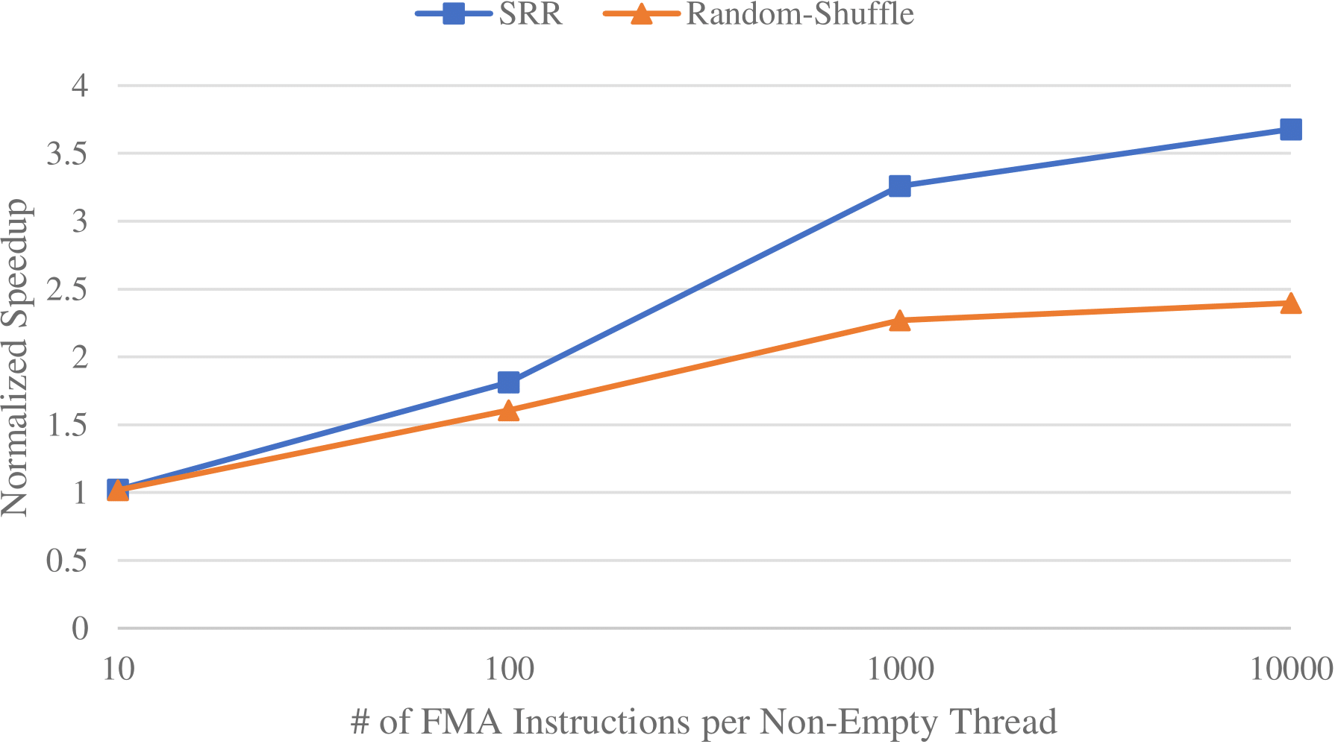
Simulated performance as imbalance scales

Slide 62
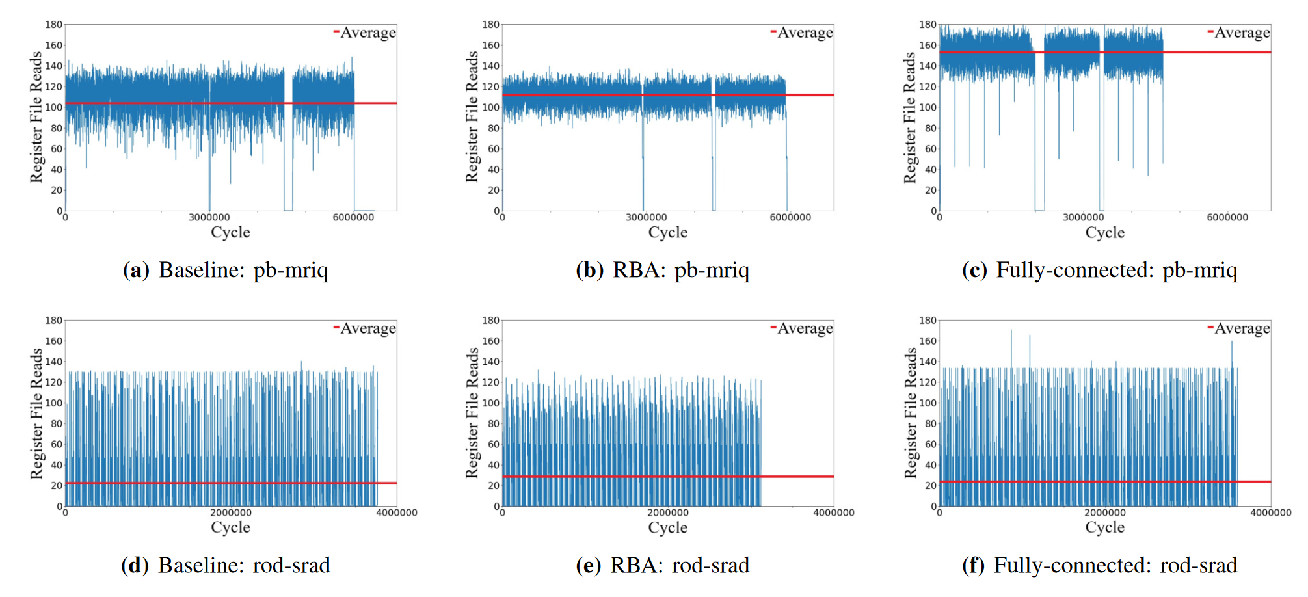
Number of 4-byte register file reads per cycle

Slide 63
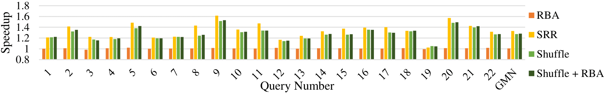
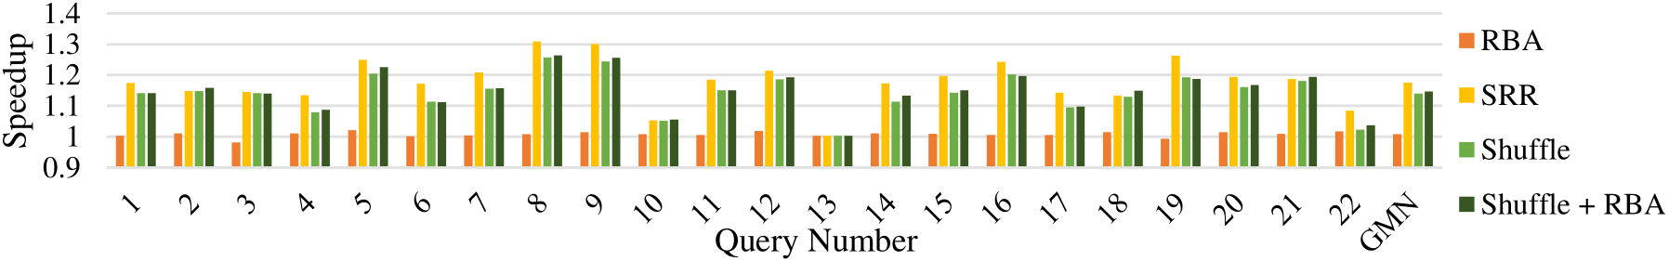
TPCH-C (top) and TPCH-U (bottom)

Slide 64
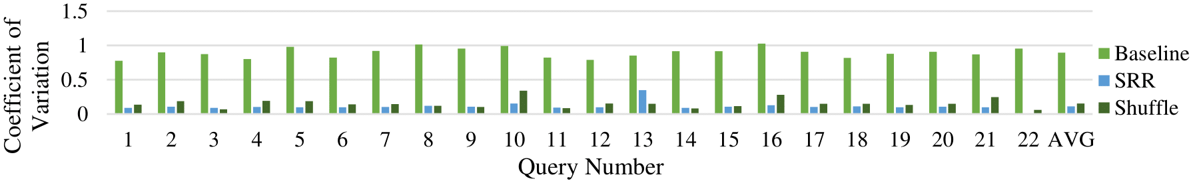
TPCH-U Coefficient of Variation of total instructions issued from each sub-core

Slide 65
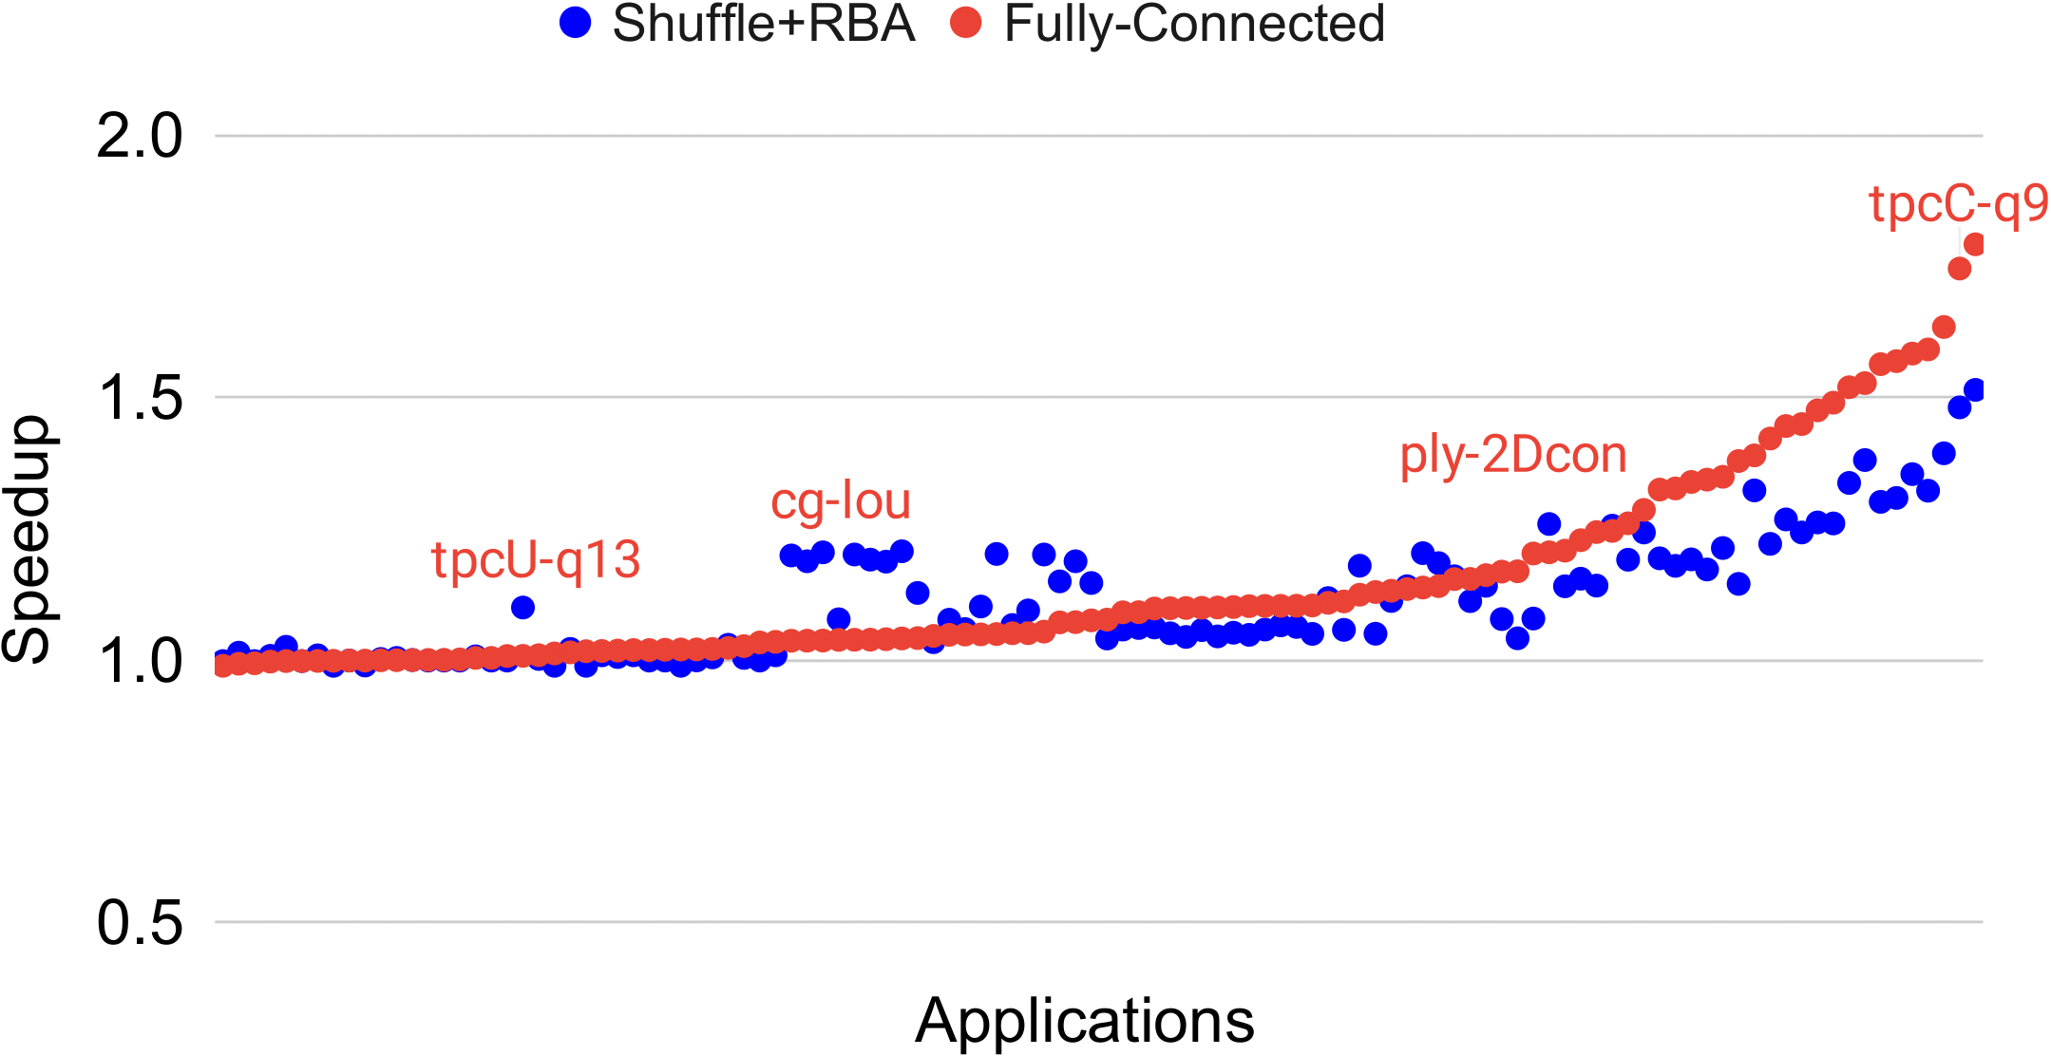
Design Performance on all applications

Slide 66
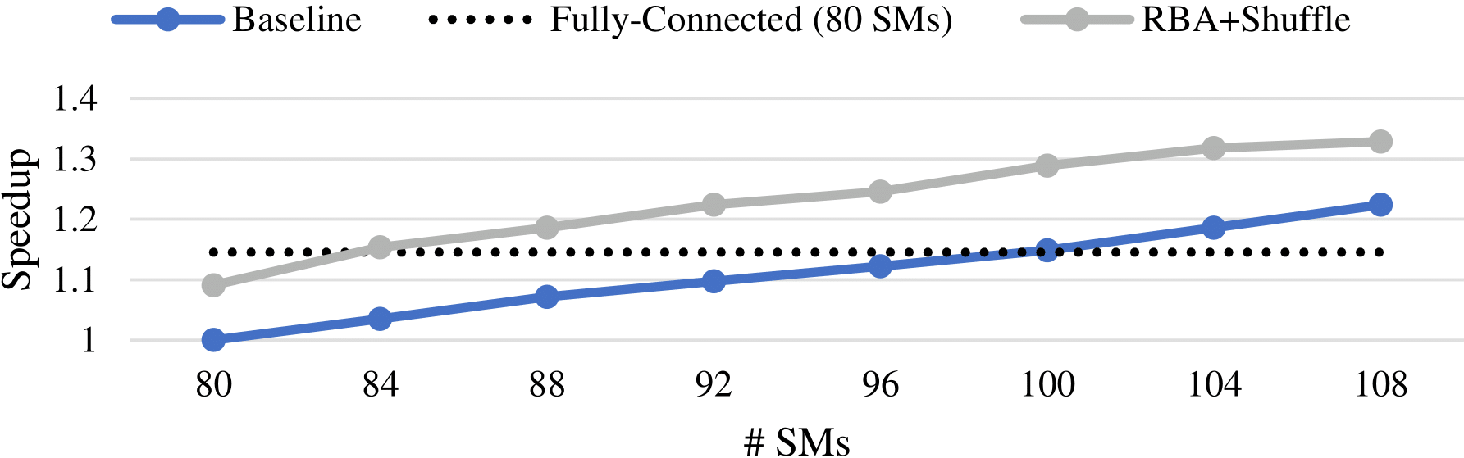
Geomean speedup of compute-bound applications over 4 sub-core baseline

Slide 67
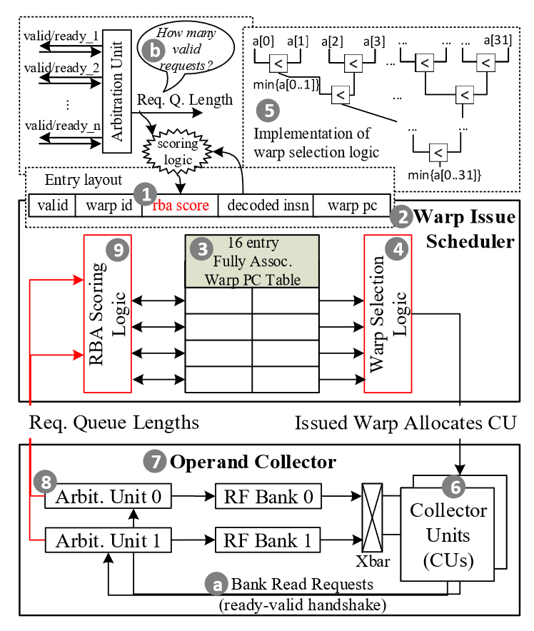
RBA Warp Scheduler
The warp scheduler selects threads to issue each cycle
Typical policies include GTO, LRR, etc.
RBA adds register file access request feedback to make better use of the limited number of CUs
Notes:
The RBA warp scheduler prioritizes warps that access register file banks with the fewest pending access requests by using feedback data from the operand collector arbitration unit. This figure shows the modifications to a baseline greedy then oldest warp scheduler necessary to implement the RBA design.

Slide 68
RBA Warp Scheduler
Define RBA score as the sum of pending read requests for each of the instruction’s operand bank (stored as 5 bits in PC table)
Notes:
We define the RBA score as the sum of pending read requests for each of the instruction’s operands. This value is stored in 5 bits in the warp PC table.

Slide 69
RBA Warp Scheduler
2. Warp Selection logic issues a warp instruction with the lowest RBA score. CU is allocated with that warp.
Reuses the comparator network used for GTO baseline
Notes:
The warp scheduler (shown as #4) is responsible for arbitrating between decoded warp instructions and selecting one to issue to an empty CU each cycle. We modify the hierarchical comparator network from the baseline GTO design to compare the bits of the RBA score and select the warp with the lowest score or selecting the oldest warp in the case of a tie.

Slide 70
RBA Warp Scheduler
3. CUs generate bank read requests and signals the arbitration unit within the operand collector
Notes:
Filled CUs generate bank read requests and signal the arbitration unit, the same as the baseline design.

Slide 71
RBA Warp Scheduler
4. The Arbitration Units sum the request queue lengths, and the RBA scoring logic updates the RBA scores for pending warps in the scheduler PC tables
Notes:
The arbitration unit sums the requests for each bank and sends the value to the scoring logic which updates the values in the warp PC table.

Slide 72
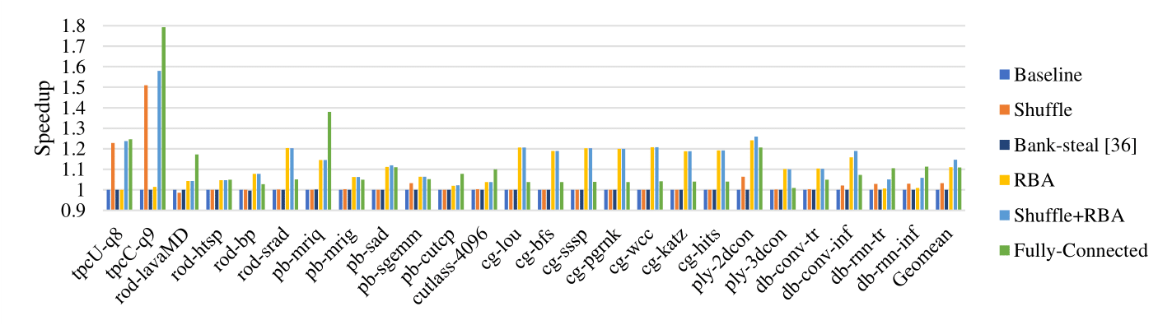
Summary Design Performance

